Slide 1


SAVEETHA SCHOOL OF ENGINEERING
SAVEETHA INSTITUTE OF MEDICAL AND TECHNICAL SCIENCES
CSA0697 DESIGN AND ANALYSIS OF ALGORITHM FOR LOWER BOUND THEORY
TOPIC:
Number of Ways to Reorder Array to Get Same BST USING DYNAMIC PROGRAMMING
Given an array nums, we want to find the number of ways to reorder it so that the resulting binary search tree (BST) is identical to the one formed from the original array.
FACULTY NAME: Dr.Gnana Soundari
By,
NAME : J.DHARSHINI
REG.NO: 192210257

Slide 2
WHAT IS DYNAMIC PROGRAMMING:
Dynamic Programming (DP) is a method for solving complex problems by breaking them down into simpler subproblems
solving each subproblem only once
storing the results for future reference.
This approach is particularly useful for optimization problems
Used for overlapping subproblems and optimal substructure properties are present.

Slide 3
Steps in Dynamic Programming
Define the State: Determine how to represent the subproblems. Define a state variable or function that captures the essence of the subproblem.
Formulate the Recurrence Relation: Establish a relationship between the solution of the problem and the solutions of its subproblems. This is typically represented as a recurrence relation or formula.
Choose a Data Structure: Decide on a suitable data structure (like arrays, matrices, or hash tables) to store the results of subproblems.
Compute the Solution: Fill in the data structure using the recurrence relation, usually starting from the base cases and working towards the final solution.
Reconstruct the Solution: Sometimes, it is necessary to reconstruct the optimal solution from the computed values, which may involve tracing back through the stored results.

Slide 4

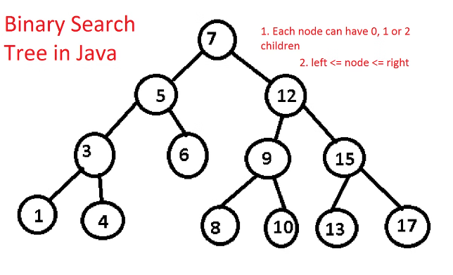
Defining a Binary Search Tree (BST)
A BST is a binary tree where for every node, all the values in its left subtree are smaller than the node's value, and all the values in its right subtree are greater than the node's value.
1
Ordered Structure
2
Unique Ordering
Each BST corresponds to a unique ordering of its nodes.
A BST maintains an ordered structure, enabling efficient search and retrieval of data.
3
Applications
BSTs are used in various algorithms and data structures, such as sorting and searching.

Slide 5

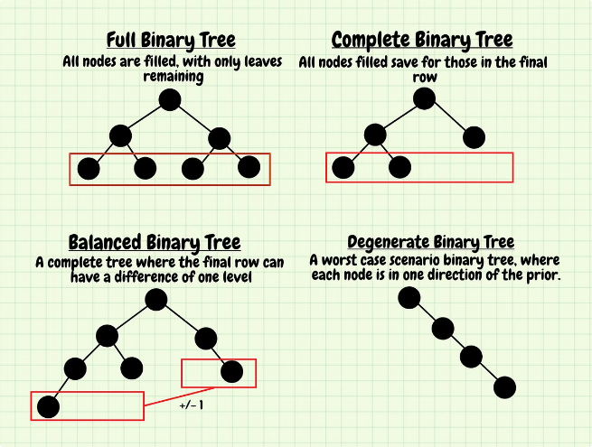
Constructing a BST from a Given Array
We construct a BST by iterating through the array and inserting each element into the tree. For each element, we compare it to the current node and insert it either in the left or right subtree, maintaining the BST property.
1
Root Node
The first element of the array becomes the root of the BST.
2
Subsequent Elements
Each subsequent element is compared to the current node and inserted appropriately, either in the left or right subtree.
3
BST Formation
The process continues until all elements are inserted, resulting in a complete BST.

Slide 6
Reordering the Array to Get the Same BST
We need to find all possible permutations of the array that, when used to construct a BST, yield the same tree structure as the one constructed from the original array.
Original Array
Reordered Array
Identical BST
The original array defines the order in which elements are inserted into the BST.
We want to find rearrangements of the array that produce the same BST structure.
The goal is to identify reorderings that result in an identical tree structure compared to the original BST.

Slide 7





Approach to Solving the Problem
We can use dynamic programming to solve this problem. We store the number of ways to reorder subarrays of the original array, considering the left and right subtrees of each node.
Base Case
For a single element, there's only one way to reorder it.
Recursive Step
For a larger subarray, we consider the number of ways to reorder its left and right subtrees and combine them.
Final Result
The final result is the number of ways to reorder the entire original array.

Slide 8

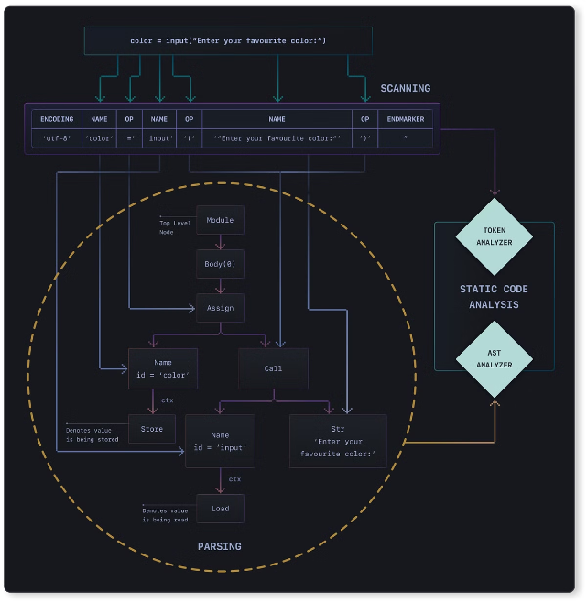
Analyzing the Time and Space Complexity
The time complexity of this approach is O(n^2), where n is the length of the array. The space complexity is O(n), mainly due to storing the number of ways to reorder subarrays.
Time Complexity
O(n^2)
Space Complexity
O(n)

Slide 9

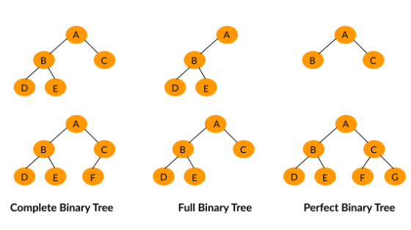

Providing Examples and Illustrations
Consider the array [2, 1, 3]. There are two ways to reorder this array to get the same BST: [2, 1, 3] and [1, 2, 3].
Original Array
Reordered Array 1
Reordered Array 2
The original array is [2, 1, 3].
The reordered array is [2, 1, 3].
The reordered array is [1, 2, 3].

Slide 10

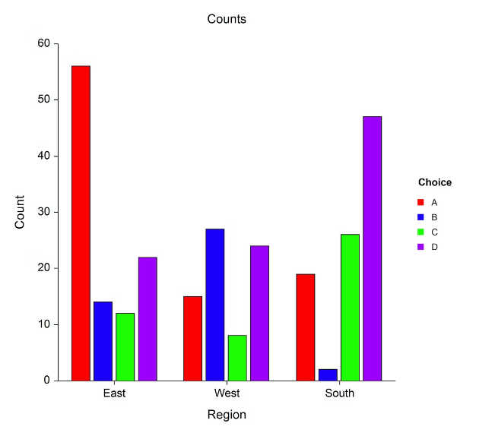
Conclusion and Key Takeaways
We have explored the problem of finding the number of ways to reorder an array to get the same BST. We utilized dynamic programming, analyzing time and space complexity, and provided illustrative examples.
BST Structure
Dynamic Programming
The unique structure of a BST determines the possible reorderings of its elements.
Dynamic programming allows us to efficiently solve this problem by breaking it down into smaller subproblems.
Complexity Analysis
Understanding the time and space complexity of the algorithm is crucial for assessing its performance.

Slide 11
THANK YOU

